Slide 1
Exception
In java
By Jyoti Shukla

Slide 2
What is Exception?
An exception is an unexpected event that occurs during program execution. It affects the flow of the program instructions which can cause the program to terminate abnormally.
OR
An Exception is an unwanted or unexpected event which occurs during the execution of a program.
i.e., at runtime, that disrupts the normal flow of the program.

Slide 3
Example of Exception:
Class Test
{
public static void main(String [] args)
{
System.out.println(“1”);
System.out.println(“2”);
System.out.println(100/0); // This will throw an Arithmetic Exception
System.out.println(“3”);
System.out.println(“4”);
}
}

Slide 4
Hierarchy of Exception
1) As We know that Object class is a parent class of all classes.
2) Throwable is a parent class of Exception and Error class.

Slide 5
Object
Throwable
Exception
Error
Occurs because of Our Program.
Recoverable
Two types:
- Compile Time Exception
(Checked Exception)
- Run Time Exception
(Unchecked Exception)
Occurs because of Lack of System Resources.
Not Recoverable.
Only One Type:
- Run Time Error
(Unchecked Error)

Slide 7
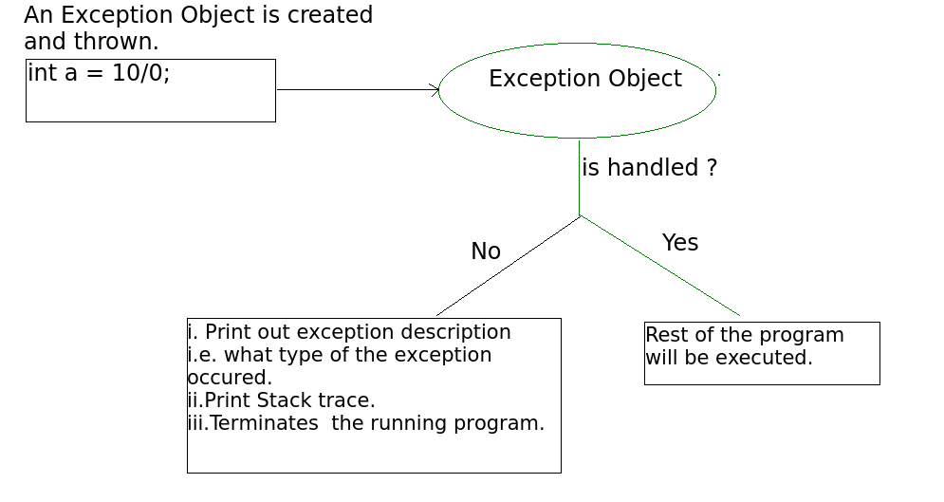
Whenever there is an Exception , the method in which Exception occurs will create an object , which will store three things:
1) Exception name
2) Description
3) Stack Trace (In which line Exception occurs).

Slide 8
Keyword to Handle Exception
We can Handle the Exception using 5 keywords.
1) try
2) catch
3) finally
4) throw
5) throws

Slide 9
Keyword | Description
try | The "try" keyword is used to specify a block where we should place an exception code. It means we can't use try block alone. The try block must be followed by either catch or finally.
catch | The "catch" block is used to handle the exception. It must be preceded by try block which means we can't use catch block alone. It can be followed by finally block later.
finally | The "finally" block is used to execute the necessary code of the program. It is executed whether an exception is handled or not.
throw | The "throw" keyword is used to throw an exception.
throws | The "throws" keyword is used to declare exceptions. It specifies that there may occur an exception in the method. It doesn't throw an exception. It is always used with method signature.

Slide 10
Method to Print Exception:
The Throwable class provides the following three methods to print the exception message:
1) Using printStackTrace Method
2) Using System.out.println(e.toString()) OR System.out.println(e);
3) Using getMessage() Method
Method | Exception Syntax
printStackTrace | Exception name, description & Stack trace
getMessage() | Only Description
toString() & syso(e) | Exception name & description

Slide 11
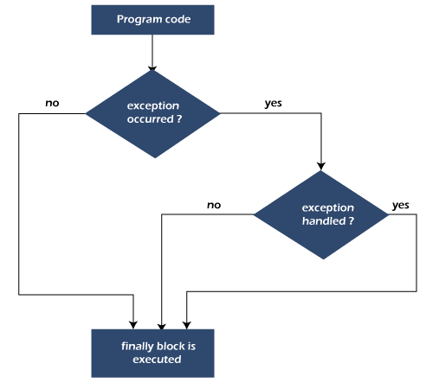
Finally:
The finally keyword is used in association with a try/catch block.
Java finally block is always executed whether an exception is handled or not.

Slide 12
Why use Java finally block?
finally block in Java can be used to put "cleanup" code such as closing a file, closing connection, etc.
The important statements to be printed can be placed in the finally block.

Slide 13
Points to be Remember:
If you don't handle the exception, before terminating the program, JVM executes finally block (if any).
For each try block there can be zero or more catch blocks, but only one finally block.
The Statement present in finally block execute even if the try block contains control transfer statement(i.e Jump Statement) like return, break or continue.

Slide 14
The possibilities that disturb the execution of finally block are:
Case 1: Using of the System.exit(0); method in try block.
Case 2: Causing a fatal error that causes the process to abort.
Case 3: Due to an Exception arising in the finally block
Case 4: The death of thread.

Slide 15
Exceptions do not occur in the program
int k = 55;
try {
System.out.println("In try block");
int z = k / 55;
}
catch (ArithmeticException e) {
System.out.println("In catch block");
System.out.println("Dividing by zero but caught");
}
finally
{
System.out.println("Executes whether exception occurs or not");
}

Slide 16
Exception occurs and corresponding catch block matches
int k = 66;
try {
System.out.println("In try block");
int z = k / 0;
System.out.println("Flow doesn't came here");
}
catch (ArithmeticException e) {
System.out.println("In catch block");
System.out.println("Dividing by zero but caught");
}
finally
{
System.out.println("Executes whether an exception occurs or not");
}

Slide 17
Exception occurs and the corresponding catch block is not found/match
int k = 15;
try {
System.out.println("In try block");
int z = k / 0;
}
catch (NullPointerException e) {
System.out.println("In catch block");
System.out.println("Dividing by zero but caught");
}
finally
{
System.out.println("Executes whether an exception occurs or not");
}

Slide 18
finally block doesn’t get execute irrespective of the exception that occurs
public static void main(String[] args){
try{
System.out.println("In try block");
System.exit(0);
}
catch(ArithmeticException e){
System.out.println("In catch block");
}
finally{
System.out.println("finally block");
}
}

Slide 19
try {
// covered by "outer" finally
}
catch (Exception1 ex) {
// covered by "outer" finally
try {
// Covered by both "inner" and "outer" finallys
}
catch (Exception2 ex) {
// Covered by both "inner" and "outer" finallys
}
catch (Exception3 ex) {
// Covered by both "inner" and "outer" finallys
}
finally { // "inner" finally
}
}
catch (Exception4 ex) {
// covered by "outer" finally
}
finally { // "outer" finally
}

Slide 20
Various possible combinations of try- catch- finally?
1. Whenever we are writing try block compulsory we should write catch or finally that is ‘try’ without catch or finally is invalid syntax.
2. Whenever we are writing catch block compulsory we should write try block that is catch without try is invalid.
3. Whenever we are writing finally block compulsory we should write try block. that is finally without try is invalid.
4. In try catch finally, order is important.

Slide 21
5. ‘try’ with multiple catch blocks Is valid but the order is important compulsory we should take from child to parent. by mistake if we are trying to take from parent to child then we will get compile time error.
6. if we are defining to catch blocks for the same exception we will get compile time error.
7. we can define try-catch-finally with in the try, with in the catch and with in finally blocks. Hence nesting of try-catch-finally is valid.
8. For try-catch-finally curly braces are mandatory.

Slide 28
throw keyword:
throw keyword is used to throw an exception explicitly.
We specify the exception object which is to be thrown.
The Exception has some message with it that provides the error description. These exceptions may be related to user inputs, server, etc.
We can throw either checked or unchecked exceptions by throw keyword.
It is mainly used to throw a custom exception.
We can also define our own set of conditions and throw an exception explicitly using throw keyword.
For example, we can throw ArithmeticException if we divide a number by another number. Here, we just need to set the condition and throw exception using throw keyword.

Slide 29
throw keyword:
1. keywords working :
try : In try block we write statements that can throw exception i.e. it maintains risky code.
catch : It maintains exception handling code i.e. alternative way for exception.
finally : It maintains clean up code i.e. closing the resources.
throw : It creates exception object manually (by programmer) and handover to JVM.
2. We can throw either checked or unchecked exception but throw is best for customized exception.
3. We can only throw class that comes in throwable child class.
4. We cannot write any statement after throw, otherwise it will provide unreachable statement error.

Slide 30
throws Keyword:
1. It is used to declare the exception. It gives an information to the caller method that there may occur an exception so it is better for the caller method to provide the exception hand ling code so that normal flow can be maintained.
2. If we call a method that declares an exception, we must either caught the exception using try catch block or declare the exception using throws keyword or say If there is any checked exception, we will get compile time error saying "unreported exception XYZ must be caught or declared to be thrown ". To prevent this compile time error we can handle the exception in two ways:
•By using try catch •By using throws keyword
3. throws keyword used to declare the checked exceptions only. If there occurs any unchecked exception such as NullPointerException, it is programmers fault that he is not performing check up before the code being used.

Slide 31
Difference between throw and throws:
throw | throws
1.throw keyword is used to create an exception object manually i.e.by programmer (otherwise by default method is responsible to create exception object) | 1.throws keyword is used to declare the exceptions ie.it indicate the caller method that given type of exception can occur so you have to handle it while calling.
2. throw keyword is mainly used for runtime exceptions or unchecked exceptions | 2. throws keyword is mainly used for compile time exceptions or checked exceptions
3.In case of throw keyword we can throw only single exception | 3. In case of throws keyword we can declare multiple exceptions i.e. void readFile() throws FileNotFoundException, NullPointerException, etc.
4. throw keyword is used within the method | 4. throws keyword is used with method signature.

Slide 32
5. throw keyword is followed by new instance | 5. throws keyword is followed by class
6. We cannot write any statement after throw keyword and thus it can be used to break the statement | 6. throws keyword does not have any such rule

